Slide 1

Project Title -
Seasonal Agriculture Performance Analysis
Student Name : SHRAVANI SACHIN KULKARNI
College Name : Zeal College of Engineering & Research
AICTE STU ID : STU674a899493ef71732938132

Slide 2

PROBLEM STATEMENT
Agricultural activities and outputs fluctuate heavily across seasons due to changing rainfall, temperatures, input costs, and resource constraints.
Raw agricultural datasets often fail to show which combination of practices actually produces profitable outcomes versus financial loss.
High production volume does not guarantee high profitability if excessive input costs and water overuse erode farm margins.
The goal of this project is to analyze 4,000 multi-seasonal farm records to identify patterns connecting environmental conditions, irrigation practices, inputs, crop yields, and economic performance.

Slide 3
Project Description
Dataset Scope: 4,000 farm records covering Kharif, Rabi, and Zaid seasons across varied soil types, input levels, and regional conditions.
Context-Based Data Cleaning: Replaced missing values using grouped domain medians—Rainfall by Season, Soil Moisture by Season and Irrigation Method, and Yield by Crop and Season.
Engineered Analytical Features: Formulated derived metrics including Cost per Tonne, Profit Margin %, Revenue per Hectare, Water per Hectare, and Fertilizer Efficiency.
Composite Evaluation: Developed a normalized Seasonal Performance Score combining Yield (35%), Profit (40%), and Water Efficiency (25%) for balanced seasonal benchmarking.

Slide 4

WHO ARE THE END USERS?
Farmers & Farmer Producer Organizations (FPOs): For choosing optimal seasonal crop varieties, cutting wasteful input expenditure, and selecting cost-effective irrigation methods.
Agricultural Policy Makers & Government Agencies: For planning seasonal water distribution, targeting micro-irrigation subsidies, and setting regional yield targets.
Agronomists & Resource Planners: For setting benchmark limits on fertilizer application to avoid diminishing financial returns.

Slide 5

Technology Used
  Programming Language: Python 3
  Data Processing & Manipulation: Pandas, NumPy
  Data Visualization: Seaborn, Matplotlib
  Development Environment: Jupyter Notebook

Slide 6
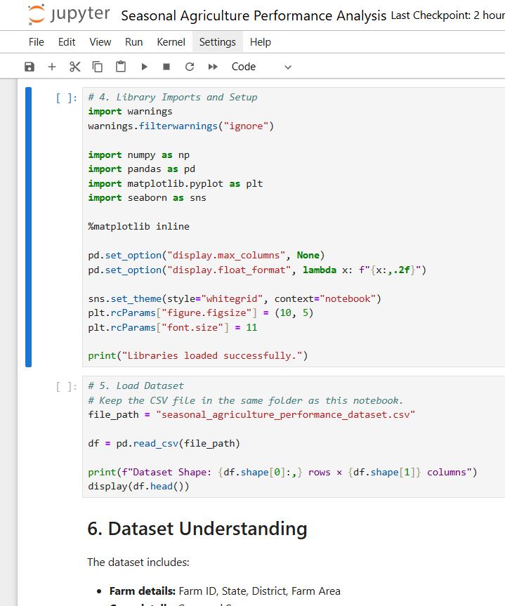
RESULTS
Environment Configuration: Imports standard data science libraries (pandas, numpy, matplotlib, seaborn) while configuring numerical display formats and suppressive warning filters.
Raw Data Loading: Reads seasonal_agriculture_performance_dataset.csv into a Pandas DataFrame to inspect initial dimensions and record layouts.
Structure Verification: Confirms file integrity by logging total observation counts and printing initial record previews via head().

Slide 7
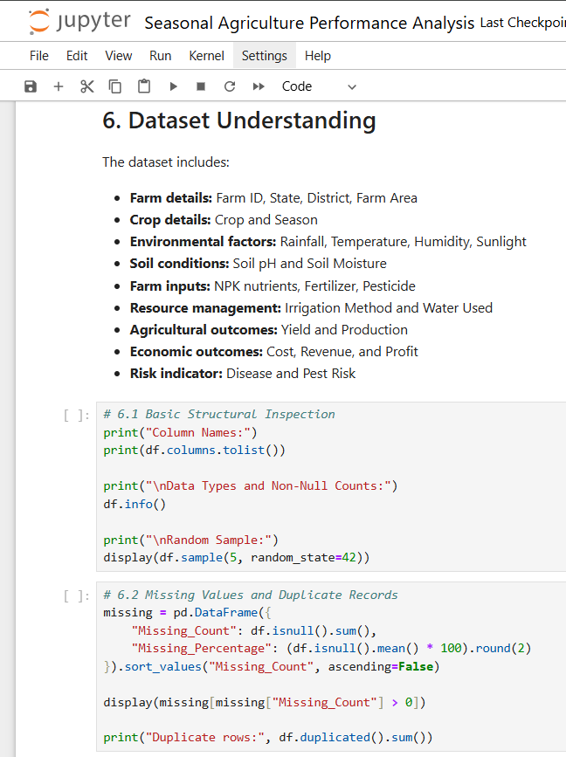
RESULTS
Attribute Scoping: Catalogs features across farm demographics, seasonal weather, soil indicators, input volumes, crop outputs, and net economics.
Integrity Auditing: Uses .info() and column listings to verify data types and identify column-wise null counts.
Duplicate & Anomaly Detection: Calculates exact missing-value percentages per attribute and scans the dataset for redundant duplicate rows

Slide 8
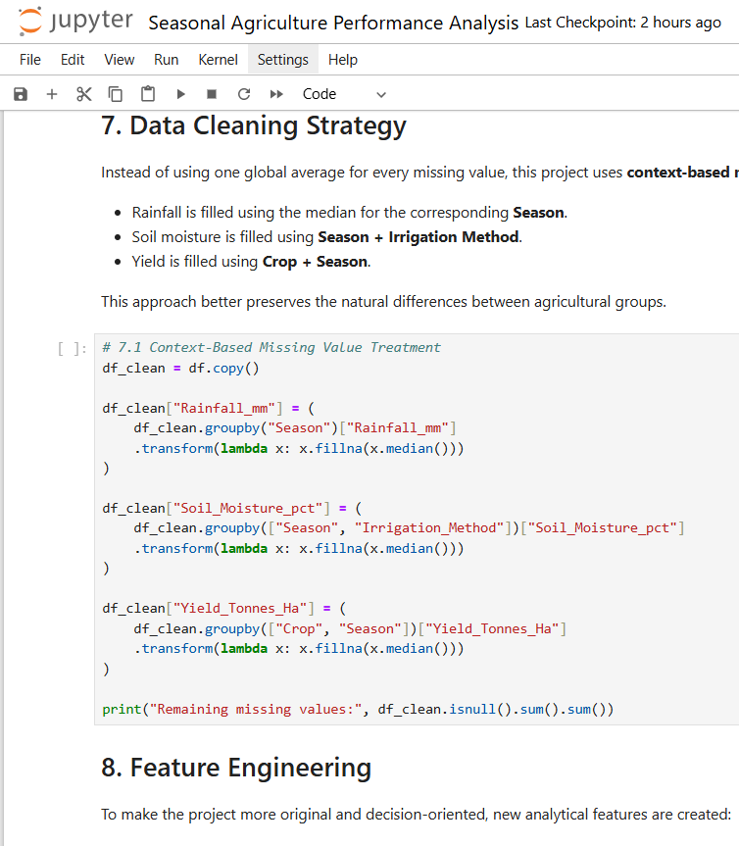
RESULTS
Domain-Specific Imputation: Replaces missing figures with grouped subgroup medians rather than applying a single distorted global average.
Stratified Imputation Logic: Imputes Rainfall_mm by Season, Soil_Moisture_pct by Season combined with Irrigation Method, and Yield_Tonnes_Ha by Crop and Season.
Null Elimination: Validates the cleaned DataFrame (df_clean) to confirm zero remaining null values without discarding valid records.

Slide 9
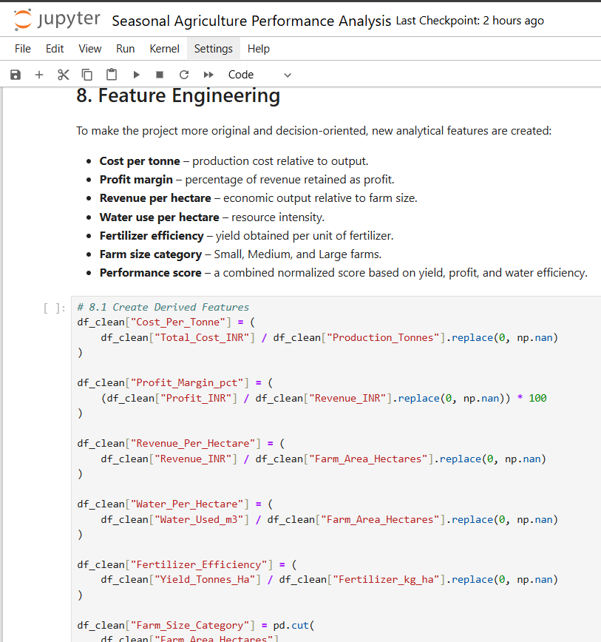
RESULTS
Economic Unit Economics: Computes Cost_Per_Tonne, Profit_Margin_pct, and Revenue_Per_Hectare to track true financial efficiency relative to land and output scale.
Resource Productivity Ratios: Generates Water_Per_Hectare and Fertilizer_Efficiency to quantify physical input efficiency per ton produced.
Categorical Segmentation: Segments farms into size cohorts (Small, Medium, Large) and categorizes operations into binary Profitable vs. Loss-Making cohorts.

Slide 10
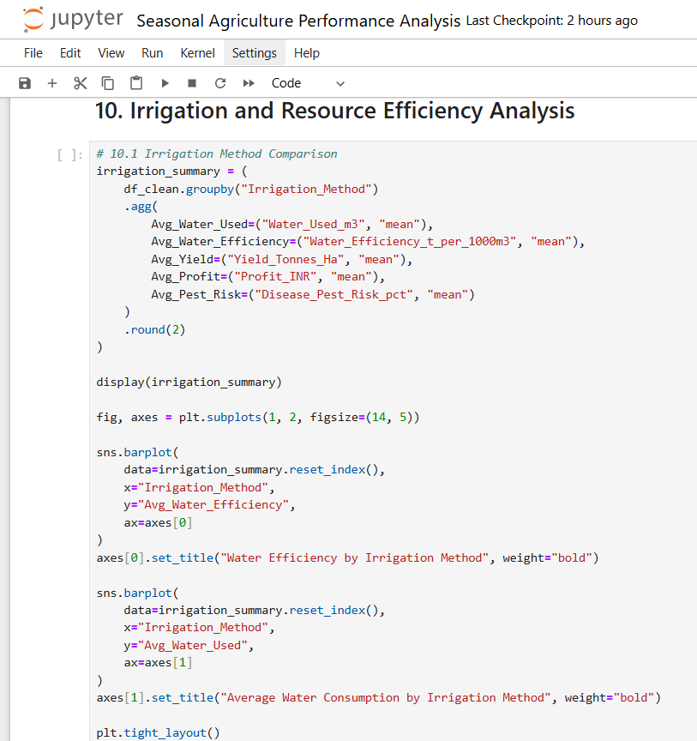
RESULTS
Irrigation Method Aggregation: Groups farms by irrigation type to compute baseline means for water consumed, yield, profit, water efficiency, and pest risk.
Comparative Visualization: Uses multi-panel Seaborn bar charts to visualize water optimization opportunities across modern and conventional methods.

Slide 11
Future scope
Possible future extensions include:
Machine learning for yield or profit prediction
Regional comparison dashboards
Weather-based agricultural forecasting
Interactive Streamlit or Power BI dashboard
Crop recommendation based on seasonal conditions

Slide 12
GitHub Link
https://github.com/ShravaniKulkarni04/Seasonal-Agriculture-Performance-Analysis.git

Slide 13
VOIS Course completion certificate -
Course name- Data Visualization

Slide 14
Thank you
.
.

